Slide 1

Insurance Loss Analytics
DSO 530 Group Project
Notes:
Freddie

Slide 2






Team Members
Phuong Vu
Shreya
Amna Gul
Anh Tuyet (Snowy) To
Chin-Wei (Wilson) Chang
Seungyun (Freddie) Lee
Notes:
Freddie

Slide 3
Project Overview
One of the main challenges in the insurance industry is setting the right premium for policyholders. Mispricing can cause adverse selection leading to financial loss.
Industry Context
Insurers need to accurately predict expected losses and adjust premiums accordingly. Accurate losses prediction will help improve premium pricing strategies, reduce the risk of adverse selection, and enhance overall portfolio profitability.
Problem Statement
Introduction
Exploratory Data Analysis
Models & Results
Business Implications
Notes:
Freddie-Problem statement: In the automobile insurance industry, claim distributions are highly skewed with many zero claims. Traditional models struggle to handle this, especially when aiming for fair and profitable pricing.

Slide 4
Project Goal
Stakeholders
Importance & Motivation
Build predictive models to help insurance companies set fair and profitable premiums
Policyholders
Seek transparent and justifiable premiums
Policymakers
Ensure market fairness and
prevent discrimination
Insurance Companies
Need to maintain profitability
Reduce underwriting risk and
support portfolio health
Promote fairness and efficiency in pricing using Tweedie-based ML models
Introduction
Exploratory Data Analysis
Models & Results
Business Implications
Notes:
Freddie

Slide 5
Task 1
Task 2
Regression
Classification
Predict: how big the claim is
LC (Loss Cost per Exposure Unit) = X.15 / X.16
Measure average cost per claim for a policyholder
HALC (Historically Adjusted Loss Cost) = LC × X.18
Adjust LC to reflect how frequently claims occur historically
Predict: the probability of any claim
Claim Status (CS):
1 = claim made
0 = no claim
Business Perspective:
Determine financial impact when that risk materializes
Business Perspective:
Assess risk of any claim
Introduction
Exploratory Data Analysis
Models & Results
Business Implications
Notes:
Phuong

Slide 6

Datetime Conversion
Convert policy start date, renewal dates, date of birth, and license issuance date to datetime.
Dataset Overview
Training Data
37,451 policy records
28 variables (X.1–X.28)
Feature Engineering
age = Age of the policyholder in years
policy_duration = Days between policy start and last renewal
driver_experience = Years since driver’s license was issued
Vehicle_age = Age of vehicle as of 2019
Numerical: X.8–X.12, X.14–X.18, X.22–X.26, X.28
Categorical: X.7, X.13, X.19–X.21, X.27
Datetime: X.2–X.6
Feature Types
Columns Dropped
X.1: A unique identifier for each policy, which doesn't provide much useful information and could introduce unwanted noise.
X.2–X.6 and X.22: We already extracted useful components using feature engineering.
15,787 policy records
Without target values (X.15–X.18)
Test Data
Introduction
Exploratory Data Analysis
Models & Results
Business Implications
Notes:
Phuong-Test data set (missing)

Slide 7
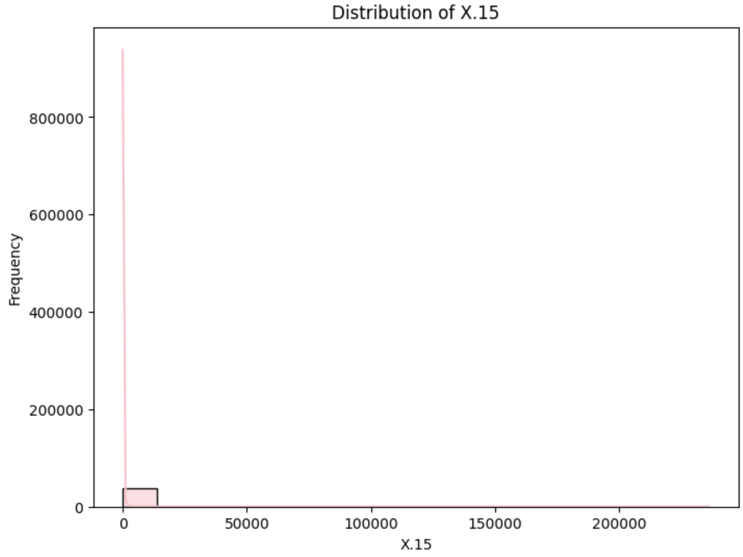
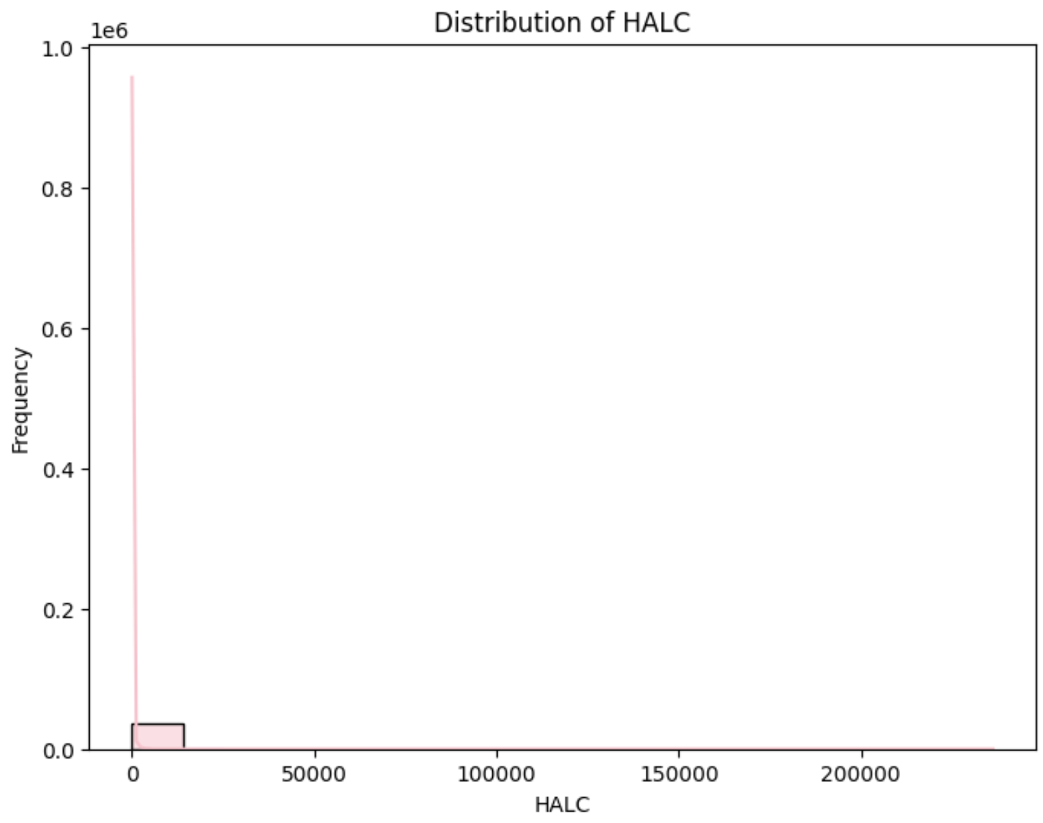
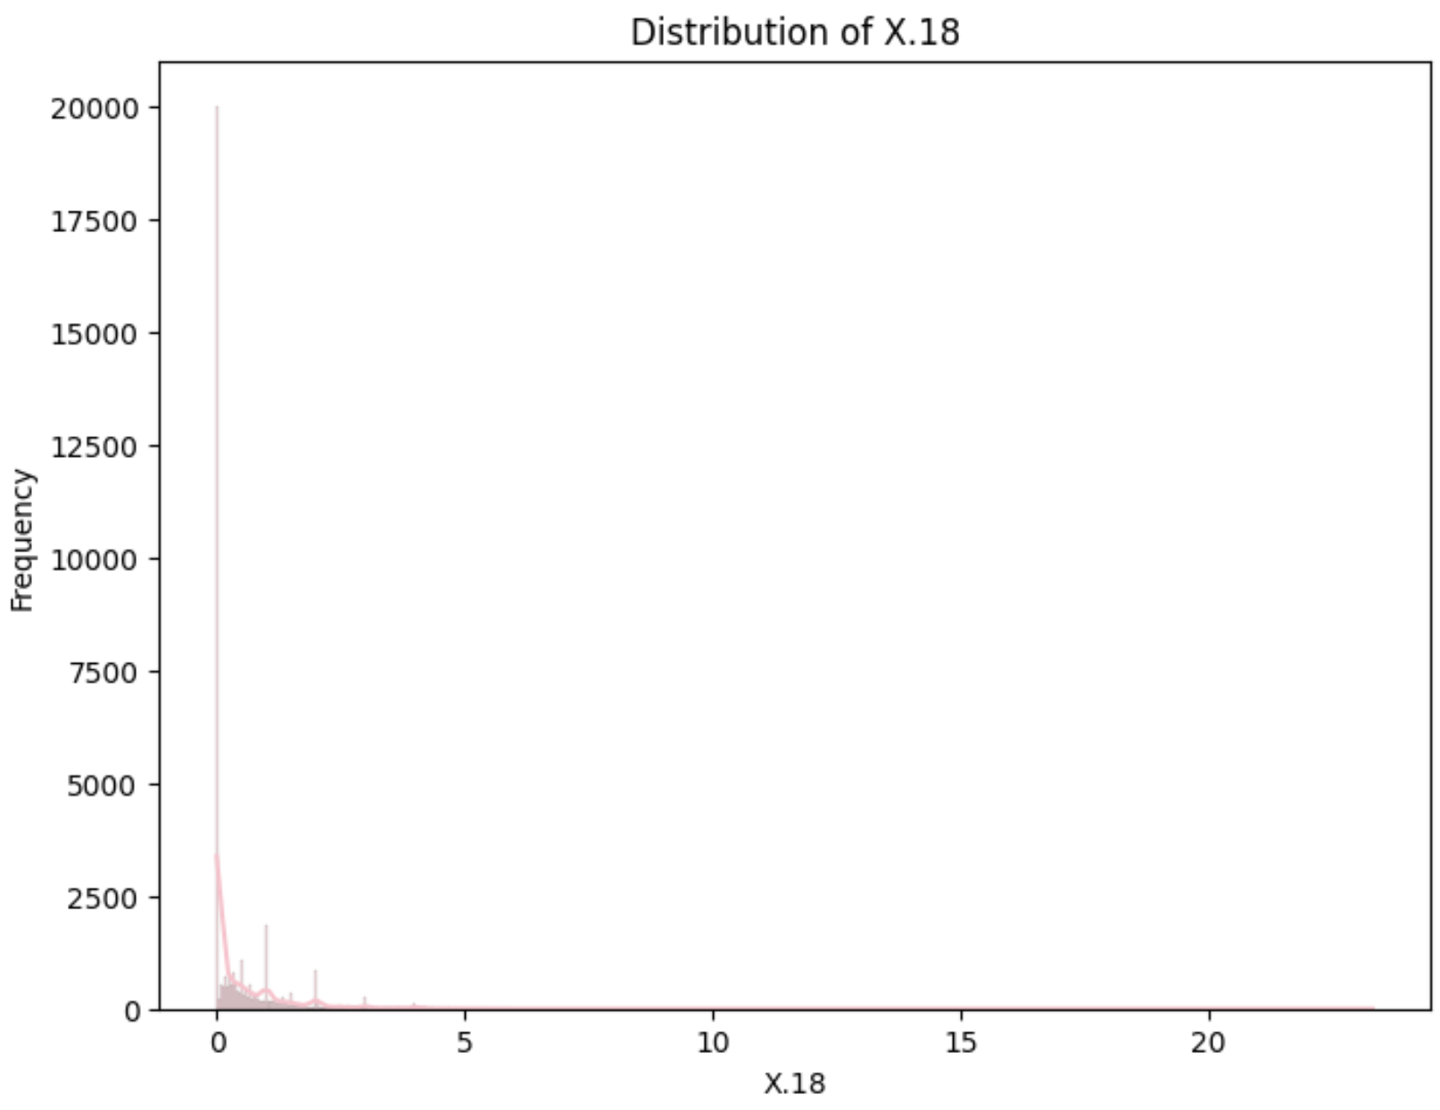
Distributions of Numerical Features
(Used for LC, HALC, CS Prediction)
X.15–Total Claim Cost
X.15 / X.16–Loss Cost
X.18–Claim Frequency
- Highly right-skewed with many zeros – most policyholders didn’t file a claim.
- Few records show extreme claim costs, highlighting rare but large incidents.
- Extreme spike at zero and long tail – many low-cost claims, few expensive ones.
- Outliers with very high per-claim costs, possibly from rare high-payout policies.
- Heavily right-skewed, with most values close to zero.
- Claims occur infrequently across most policies.
Introduction
Exploratory Data Analysis
Models & Results
Business Implications
Notes:
Add 18 for 14
LC HALC

Slide 8
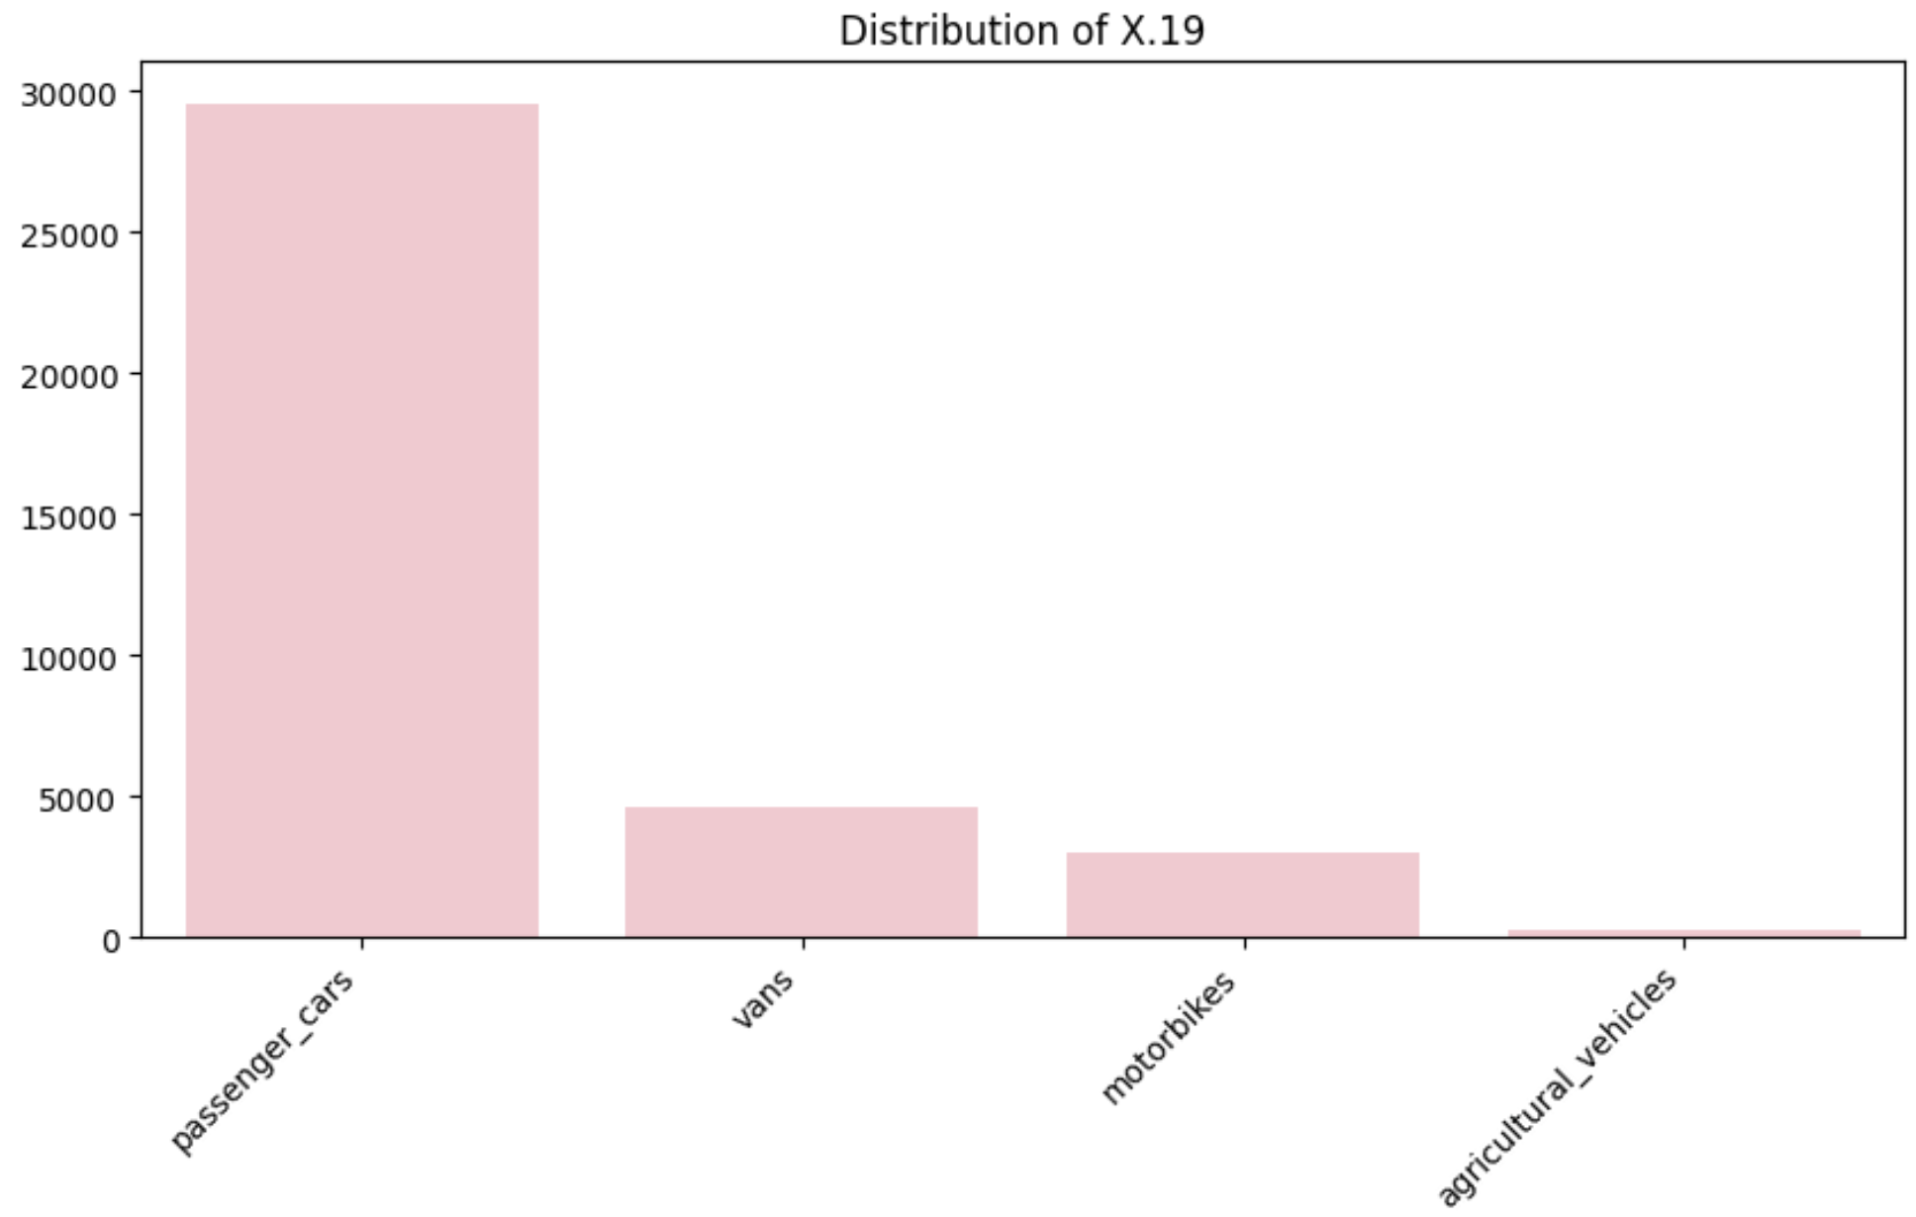
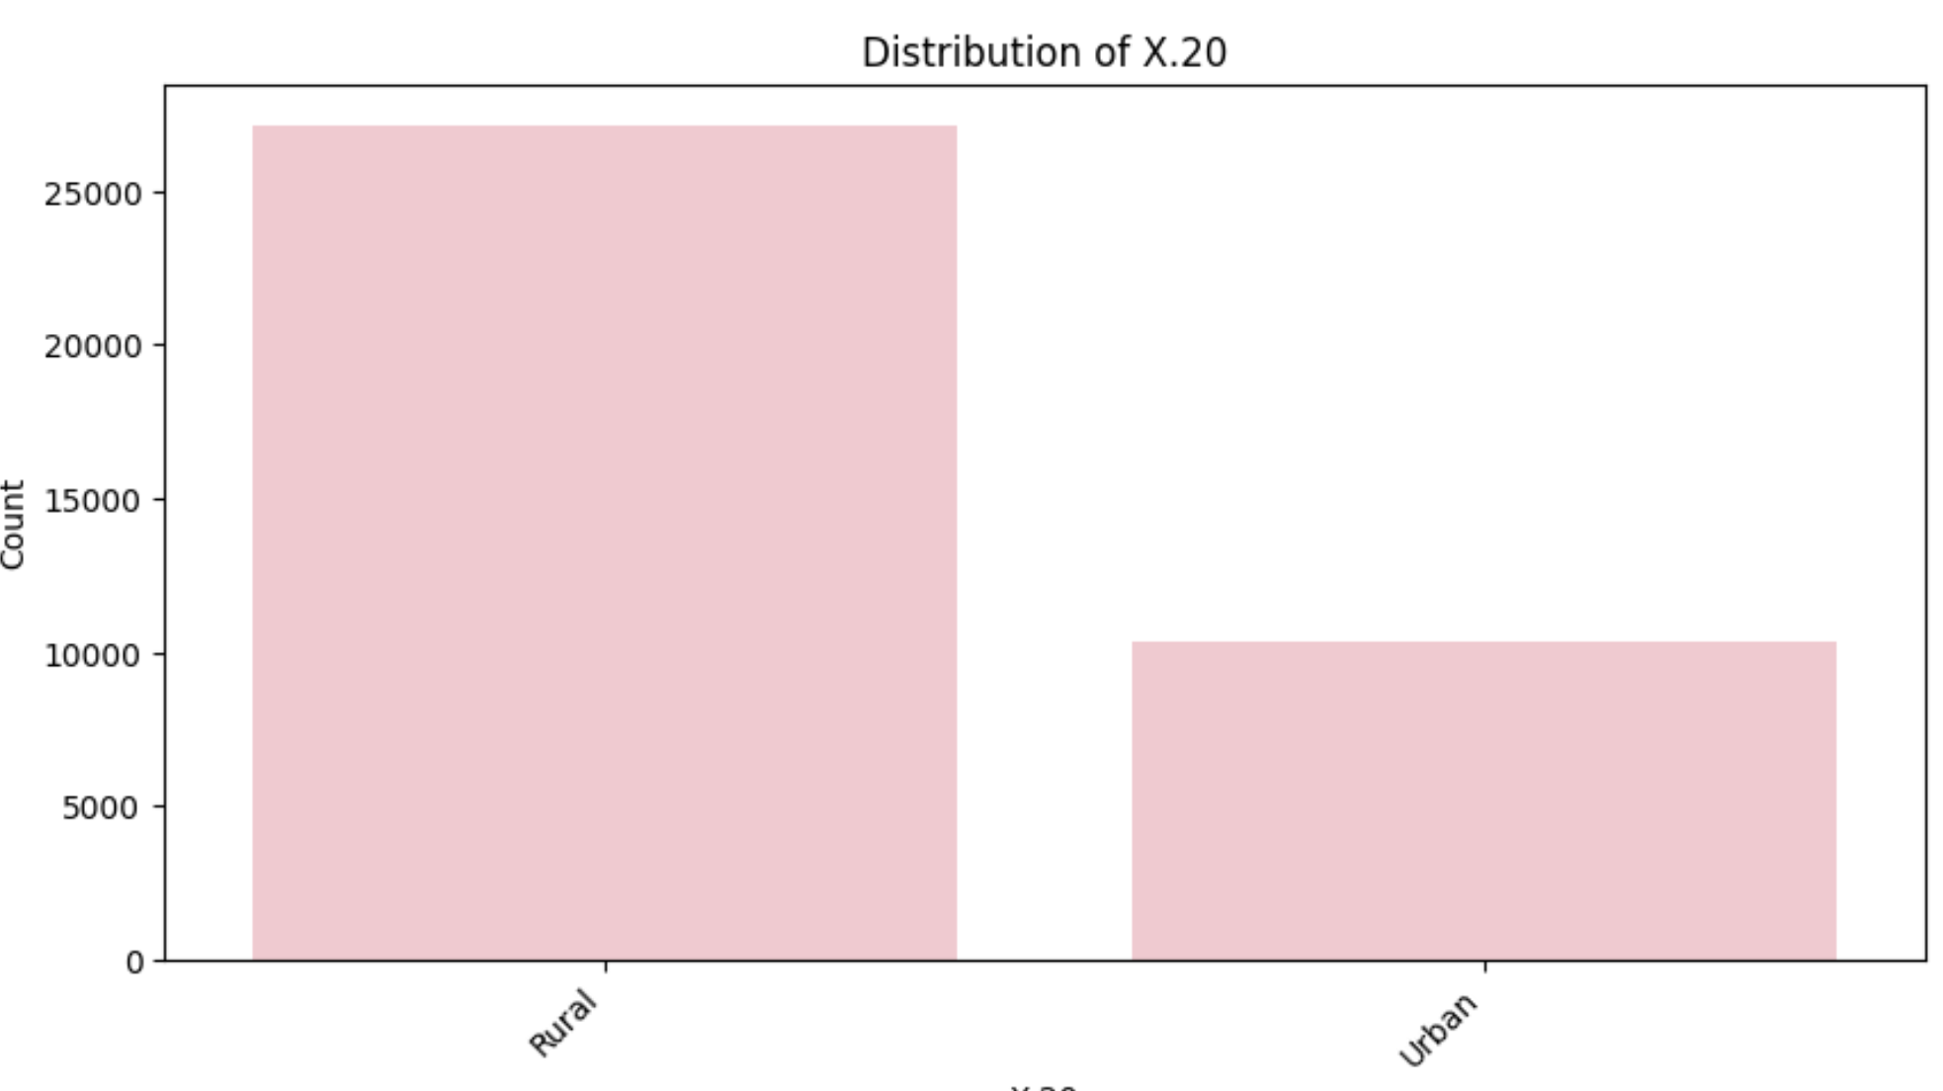
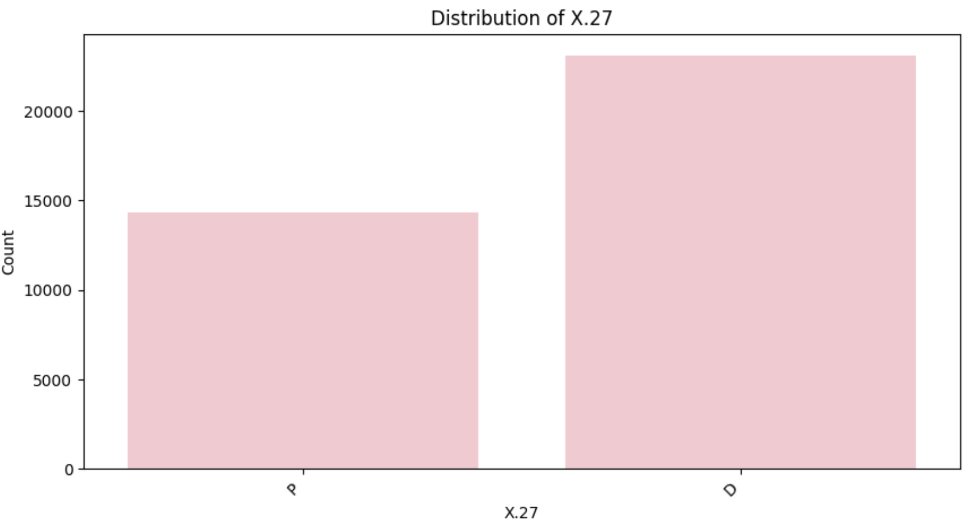
Distributions of Categorical Features
X.19–Vehicle Type
X.20–Region Type
X.27–Fuel Type
- Passenger cars make up the vast majority of insured vehicles.
- Vans and motorbikes represent much smaller segments.
- Very few agricultural vehicles, indicating they may have limited impact on the model.
- The dataset is dominated by rural customers, with urban policyholders being a smaller group.
- Majority of vehicles run on diesel, but petrol still forms a significant portion.
- Class balance is relatively better than other categorical features.
Introduction
Exploratory Data Analysis
Models & Results
Business Implications
Notes:
Add 18 for 14
LC HALC

Slide 9
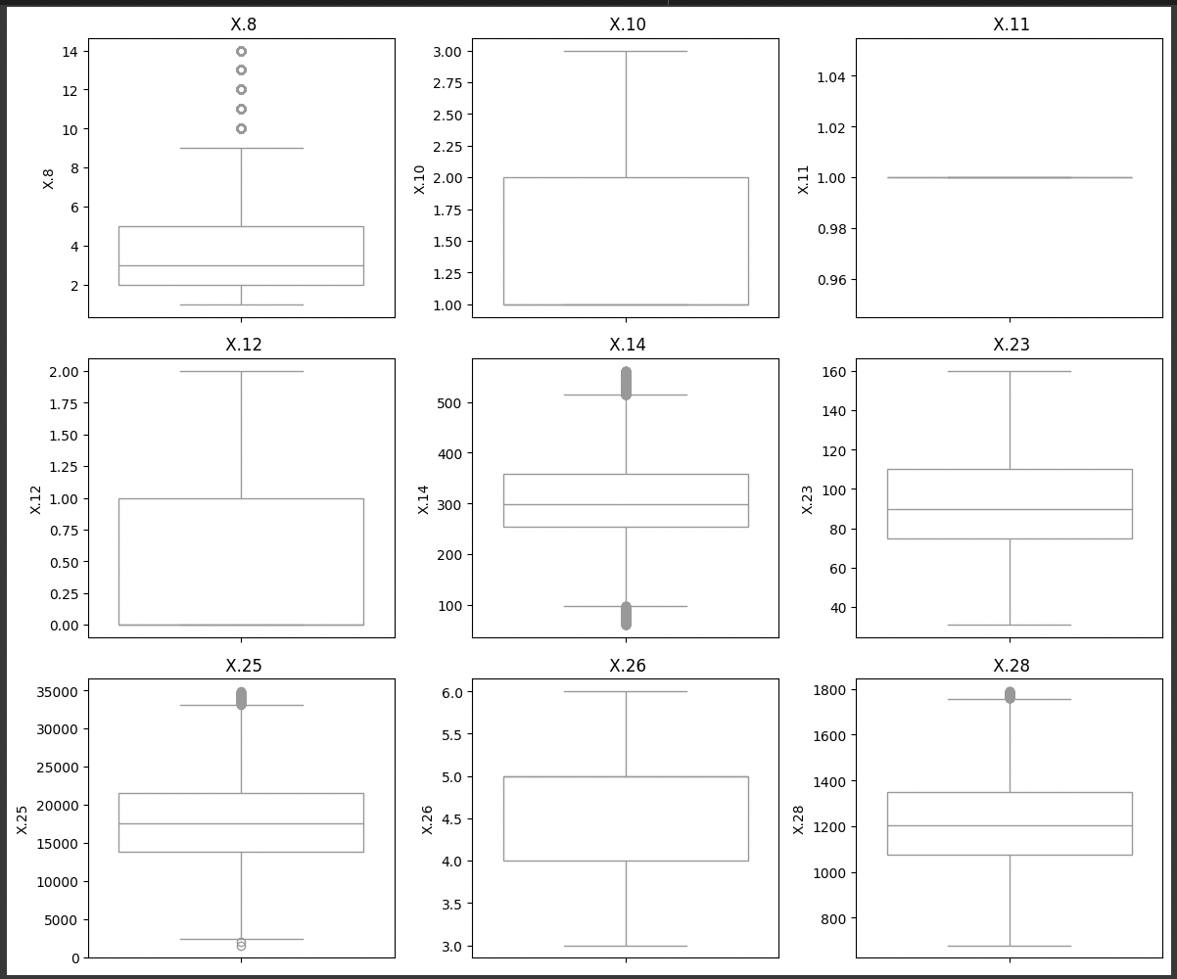
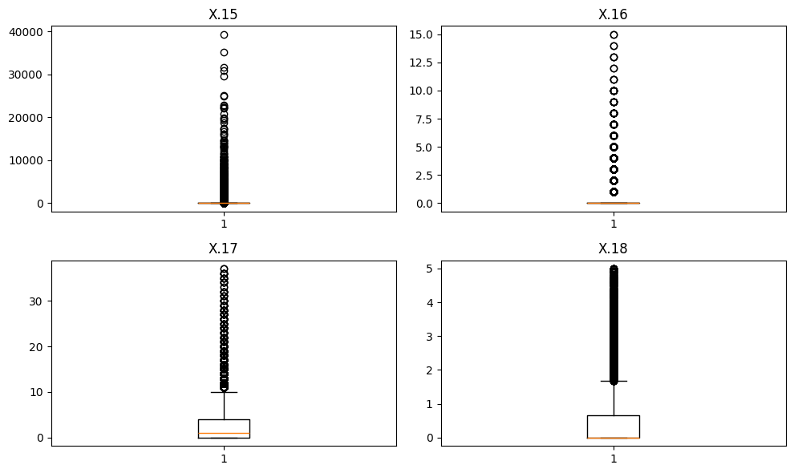
Handling Outliers
Regression
Classification
Thresholds Applied
Thresholds Applied
Outliers beyond 1.5 × IQR from the 1st and 3rd quartiles
X.15 > 40000
X.16 > 15
Less than 0.1% of rows were removed in total
~36% of rows were removed in total
X.17 > 40
X.18 > 10
Introduction
Exploratory Data Analysis
Models & Results
Business Implications
Notes:
Left side-clasiification(manually)--after results Right side- regression(3std dev.)--after results

Slide 10
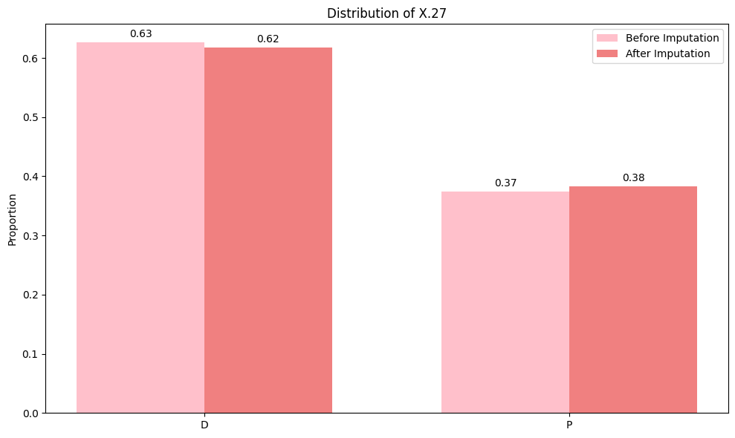
Handling Missing Values in X.27 (Fuel Type)
Approach
Comparison
Imputed using supervised classification models
Features used: X.19, X.23, X.24, X.25, X.28
Final imputed values were integrated back into the training dataset
Model | Decision Tree / Random Forest | XGBoost | LightGBM
Accuracy | 99.76% | 96.31% | 94.7%
Recall (D / P) | 1.00 / 1.00 | 0.98 / 0.94 | 0.97 / 0.91
Observation | Overfit to training set, poor recall on minority class P | Best balance between performance and generalization; strong recall on both classes, especially minority P | Slight underfitting, missed both classes more often
Introduction
Exploratory Data Analysis
Models & Results
Business Implications

Slide 11
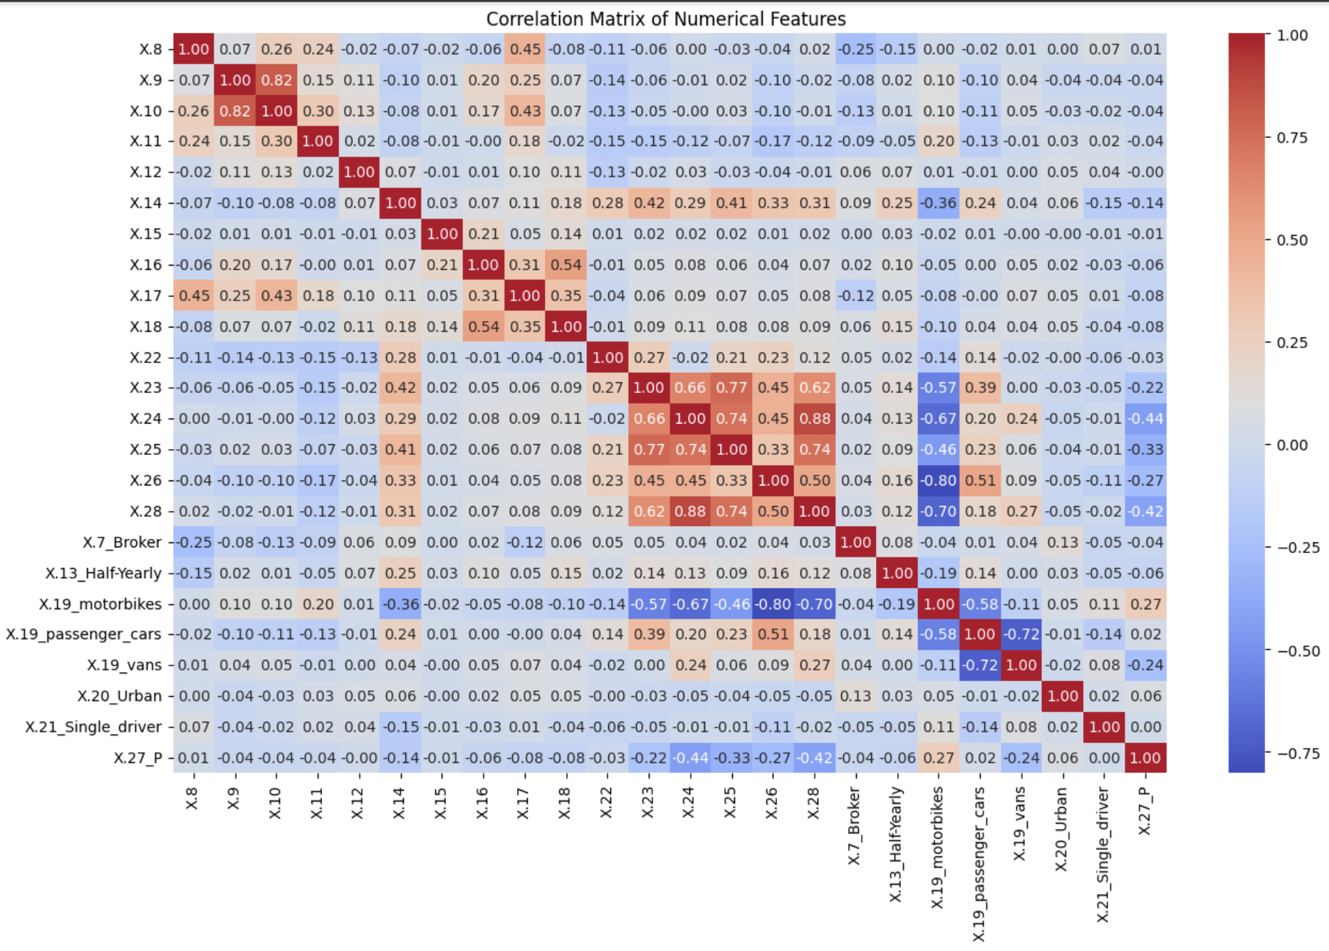
Features Used & Correlation Heatmap
Columns with correlation > |0.8|
'X.9' and 'X.10' = 0.82
'X.24' and 'X.28' = 0.88
'X.26' and 'X.19_motorbikes' = -0.8
Columns dropped
Drop 'X.9', 'X.24', 'X.19_motorbikes' columns apart from date and year columns
Final features used
Numerical: 'X.8', 'X.10', 'X.11', 'X.12', 'X.14', 'X.23', 'X.25', 'X.26', 'X.28'
Categorical: 'X.7_Broker', 'X.13_Half-Yearly', 'X.19_passenger_cars', 'X.19_vans', 'X.20_Urban', 'X.21_Single_driver', 'X.27_P'
Prediction: 'LC', 'HALC', 'CS'
Introduction
Exploratory Data Analysis
Models & Results
Business Implications
Notes:
Amna- Create a corr graph for all the variables listed (except CS), mention the threshold and the variables removed and then final variables used.
X.8
X.9
X.10
X.11
X.12
X.14
X.23
X.24
X.25
X.26
X.28
CS
age
policy_duration
driver_experience
Vehicle_age
Policies_Dropped
X.7_Broker
X.13_Half-Yearly
X.19_motorbikes
X.19_passenger_cars
X.19_vans
X.20_Urban
X.21_Single_driver
X.27_P

Slide 12
Regression * — Prediction Target: LC & HALC Evaluation Metric: RMSE
Model Type | Model | LC | HALC
Linear | Tweedie Regression | 573.67 | 1078.13
Non-Linear | LightGBM | 571.79 | 1072.38
 | XGBoost | 574.04 | 932.68
 | Neural Network | 458.92 | 718.54
Classification — Prediction Target: CS Evaluation Metric: ROC-AUC
Model Type | Model | ROC-AUC Score
Linear | Logistic Regression | 0.74
Non-Linear | XGBoost | 0.85
 | Random Forest | 0.82
 | Neural Network | 0.71
*All models trained using Tweedie Loss Function
Introduction
Exploratory Data Analysis
Models & Results
Business Implications
Notes:
Amna

Slide 13
Business Understandings
Business Perspective
Key Challenges
Variable Selection
Applicability
Prediction accuracy is more critical for setting proper premiums.
Accurate risk prediction ensures profitability and protects against adverse selection.
The cost of inaccurate predictions outweighs the need for full model transparency.
Highly skewed and zero-inflated data: Rare, costly claims challenge prediction.
Complexity vs. Interpretability: Models must balance accuracy and transparency.
Generalization to new customers: Models must adapt to unseen policyholders.
Driver characteristics
Vehicle attributes
Policy details
Location information
Car insurance model cannot be directly used for life insurance.
Different risk objects (vehicle vs human life)
Different predictive features
Introduction
Exploratory Data Analysis
Models & Results
Business Implications
Notes:
On this slide, we outline the key business implications that shaped our modeling decisions.
Starting with the Business Perspective: While some interpretability is necessary for compliance and transparency, our focus is on prediction accuracy. Accurately predicting risk is essential for setting proper premiums, ensuring profitability, and protecting against adverse selection. Inaccurate predictions pose a bigger risk to the business than a lack of full model transparency.
Moving to the Key Challenges: First, our data is highly skewed and zero-inflated — most policyholders have no claims, but the few that do can be very costly. Second, there's a tradeoff between model complexity and interpretability — we need models that are both accurate and explainable. Finally, the model must generalize well to new customers, not just fit past data.
Under Variable Selection, we focused on driver characteristics, vehicle attributes, policy details, and location — all of which are critical predictors of risk and readily available at the time the policy is issued ( even for new driver).
And finally, in terms of Applicability, the car insurance model we built is specific to auto-related risks. It can’t be directly reused for life insurance, since the underlying risk object — the vehicle vs. a human life — and the predictive features are entirely different.
These implications guided our approach to balancing business needs, regulatory requirements, and technical decisions throughout the modeling process.

Slide 14
THANK
YOU!

